Slide 1

ECEN 461
Real-Time and Embedded Systems
IOT – Information – FIR Filters

Slide 2
Typical DSP System
x(t)
A-to-D
x[n]
COMPUTER
y[n]
D-to-A
y(t)
Reminder, what do we need prior to the inputting a signal into an ADC?
Anti-Aliasing Filter
What type of filter is this and why do we need it?
x(t)
Anti-
Aliasing
Filter
x(t)
A-to-D
x[n]
COMPUTER
y[n]
D-to-A
y(t)

Slide 3
Typical DSP System
x(t)
Anti-
Aliasing
Filter
x(t)
A-to-D
x[n]
COMPUTER
y[n]
D-to-A
y(t)
Reminder, what do we need after the D/A to output a signal?
Low Pass Filter
Why do we need it?
x(t)
Anti-
Aliasing
Filter
x(t)
A-to-D
x[n]
COMPUTER
y[n]
D-to-A
y(t)
Low-
Pass
Filter
y(t)

Slide 4
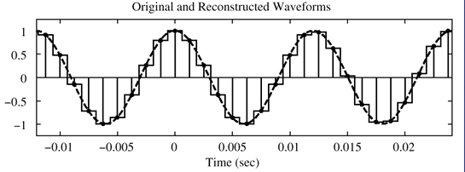
Output of a D/A
Output of a D/A is typically a stair step wave
From the Fourier Series, what frequencies are in a stair step wave

Slide 5
RC Low Pass Filter
R
C
0
-10
-20
1
Spectrum of Stair Step Wave (one side)
Spectrum of Low Pass Filter (one side)
What is the spectrum of an RC LP Filter?
What mathematical operation takes place when you send a square wave through a LP Filter?
Convolution

Slide 6
Output of a D/A after LP Filter

Slide 7
General Digital Processing System
x(t)
Anti-
Aliasing
Filter
x(t)
A-to-D
x[n]
COMPUTER
y[n]
D-to-A
y(t)
Low-
Pass
Filter
y(t)
For this system, what are some things the computer can do on x[n] to get y[n]?
Process Algorithms
DFT, FFT, Filters, etc
Pointwise Operators
Squaring: y[n] = (x[n])²
Maximum (over some number of inputs)
Running Average
Rule: “the output at time n is the average of three consecutive input values”
Lets study Finite Impulse Response Filters (FIR Filters)

Slide 8
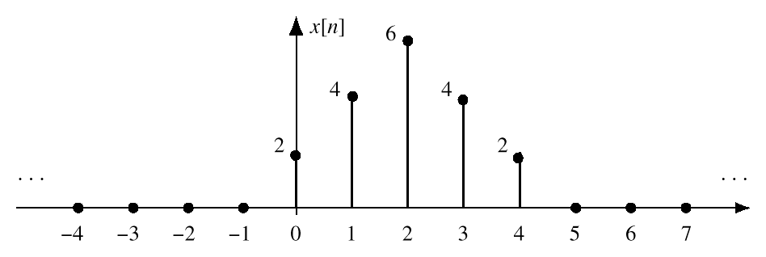
3-Point Average System
Average 3 Consecutive Numbers
Do this for each “n”
What would the mathematical equation look like?
How would we use this equation with this data?
This is called a difference equation

Slide 9
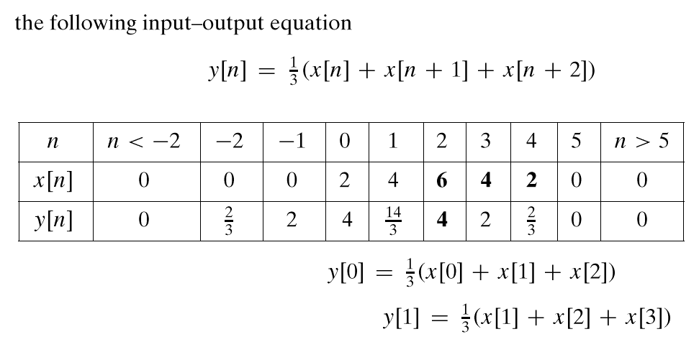
3-Point Average System
Make a Table
n =0
n =1

Slide 10
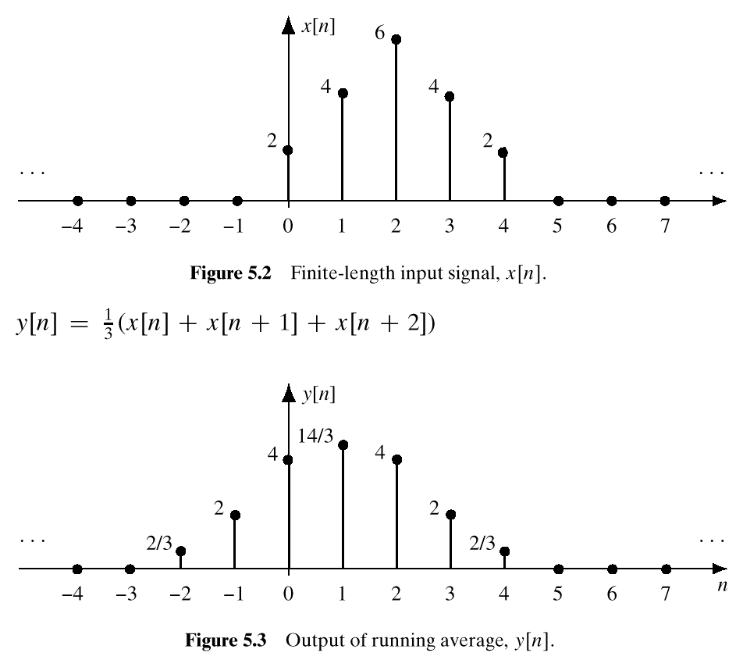
3-Point Average System
Input Signal
Output Signal

Slide 11
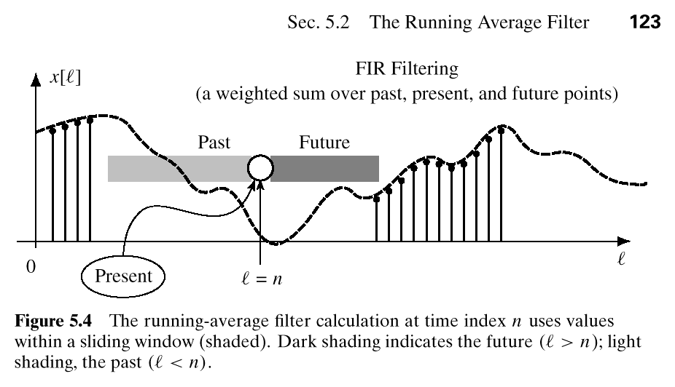
Past, Present, and Future
“n” is Time

Slide 12
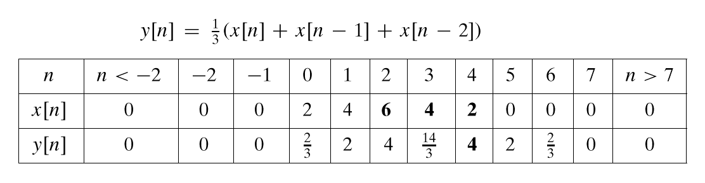
Another 3-point Averager
How could we use “Past” Values of x[n]?
Important if “n” represents real time
When x[n] & y[n] are streams of data
What would the plot of this look like?

Slide 13
General FIR Filter
Filter Coefficients {b_{k}}
Filter Order is M
Filter Length is L = M+1
Number of Filter Coefficients is L
From what you know about DSP processors, what is interesting about this formula?

Slide 14
General FIR Filter
What are the filter coefficients?
Another example,
What would the difference equation be?

Slide 15
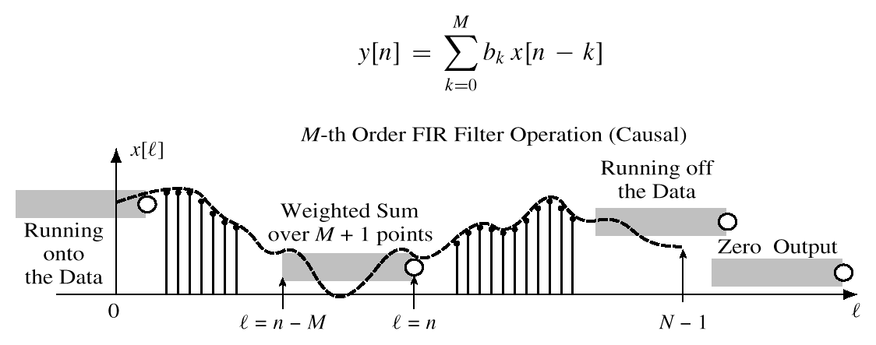
General FIR Filter
Slide a Window across x[n]

Slide 16
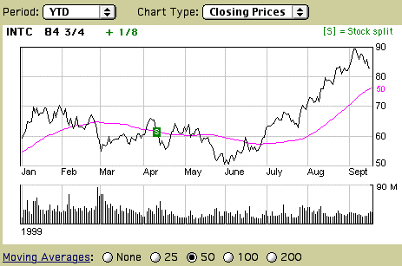
Filtered Stock Signal
Input
Output
50-pt Averager

Slide 17
Another Filtering Example
3-point Averager
7-point Averager
Lets see what happens when we put a Sinusoid through these Filters

Slide 18
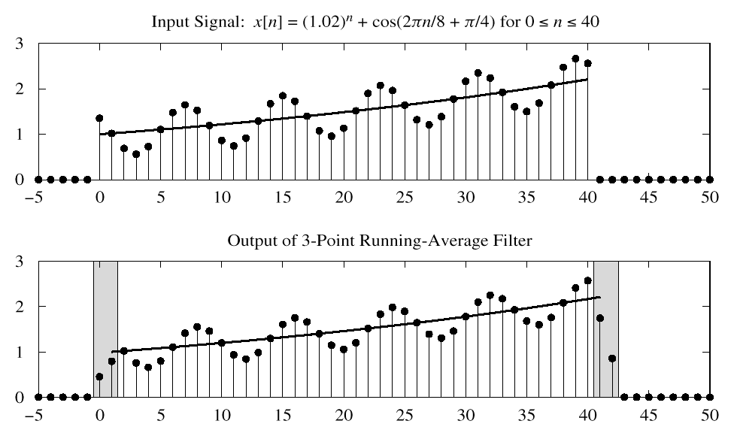
3-pt FIR Average Example
USE PAST VALUES

Slide 19
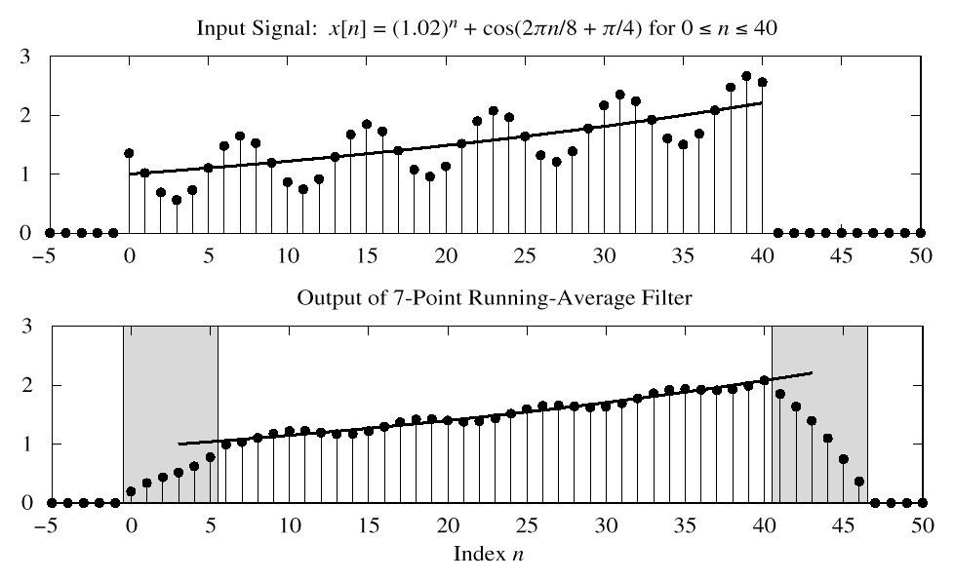
7-pt FIR Average Example
CAUSAL: Use Previous
LONGER OUTPUT

Slide 20
MATLAB - FIR Filter
yy = conv(bb,xx)
Vector bb contains the Filter Coefficients
Vector xx contains the input signal
SPFirst: yy = firfilt(bb,xx)
Filter Coefficients {b_{k}}
conv2()
for images

Slide 21
FIR Filter Examples
What are the 4 main types of filters you are familiar with?
Low Pass
High Pass
Band Pass
Band Stop

Slide 22
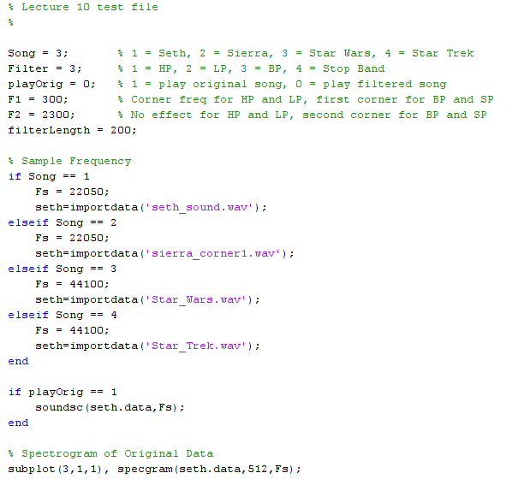
Example FIR Filter Program

Slide 23
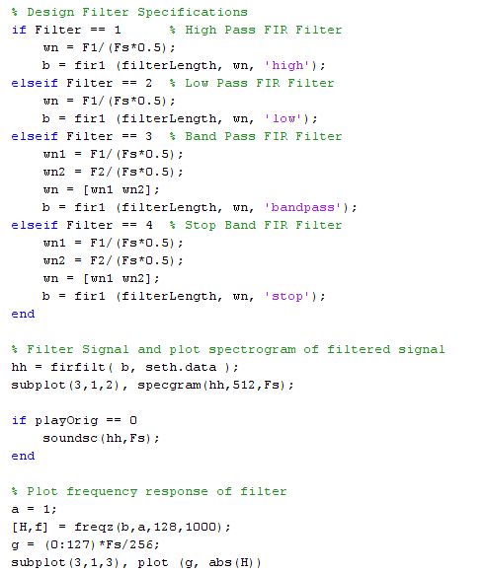
Example FIR Filter Program

Slide 24
Band Pass Example
Band Pass [300 2300]
How does it sound?
What implications does this have?

Slide 25
Backup

Slide 26
Real life problem
CD’s are sampled at 44.1kHz
Some audio players only handle data at 22kHz rates
What happens if we play the CD at 22kHz?
Slooooow Music
What can we do?
We can change the sample rate of the CD
2 Techniques
Decimation – Process of reducing the sampling rate
Interpolation – Process of increasing the sampling rate

Slide 27
Downsampling
Downsampling - the process of reducing the sampling rate of a signal by an integer number
Simply a matter of picking every i^{th} sample in the sequence and discarding the rest

Slide 28
Decimation
Decimation - Combination of down-sampling and pre-filtering a signal
Process of “sampling” a digital signal
If we do not do this, high freq components can/will distort desired signal (just like sampling in the first place)
x₁[n]
?
Filter
Down
Sample
x₂[n]

Slide 29
Upsampling
Upsampling - the process of increasing the sampling frequency of a signal by an integer number
Simply a matter of inserting 0’s between every two successive samples

Slide 30
Interpolation
Interpolation - Combination of up-sampling and post-filtering a signal
If we insert 0’s, we need to post filter the signal so it will not have sharp discontinuities
x₁[n]
?
Up
Sample
Filter
x₂[n]

Slide 31
3 Special Input Signals
x[n] = sinusoid
x[n] = unit step
x[n] has only one Non-Zero Value
Frequency Response (Later)
Next time
Unit - Impulse
1
n

Slide 32
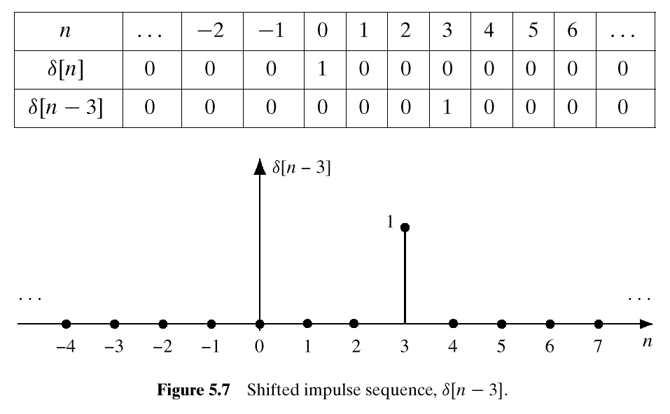
Unit Impulse Signal δ[n]
δ[n] is NON-ZERO
When its argument
is equal to ZERO

Slide 33
Math Formula for x[n]
Use Shifted Impulses to write x[n]
Stem Plot

Slide 34
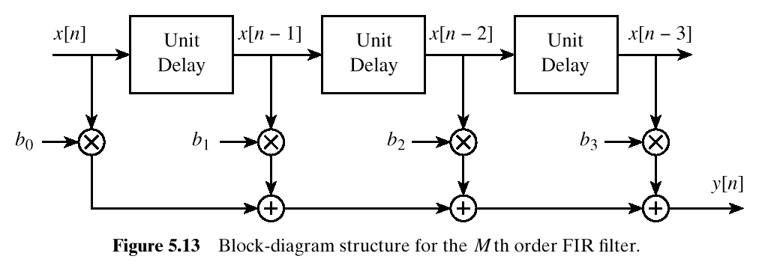
FIR Structure
Direct Form
SIGNAL
FLOW GRAPH

